Slide 1
Openflow App Security
Chao SHI
Stephen Duraski

Slide 2
Background
Software-defined networking
Control plane abstraction
Abstract topology view
Abstraction make things much simpler
More Innovation in control mechanisms and security products.

Slide 3
Motivations
Information Deficiency Challenge
No key state tracking (TCP session)
Security Service Composition Challenge
Software not decomposable.
DPI-based signatures does not produce flow rules
Threat Response Translation Challenge
Need more complex security directives
Examples
Quarantine modules
Flow Redirection Modules
Traffic Control Modules (defend DDoS)
Notes:
It should be that traffic scanner module linked to threat mitigating modules
If we use the traditional DPI-based legacy security, no api can help us generate the flows from
more flows, network-wide attacks
quarantine

Slide 4
Basic Problem
Is there a way to make the security app development faster on Openflow?
Instead of implementing a new security software from scratch, can we migrate the legacy software (Snort) on Openflow directly?

Slide 5
What is FRESCO
Framework for Enabling Security Controls in OpenFlow networks
Application development framework
module composition
accelerate development cycle
How it answers our question
Scripting API
16 commonly reusable modules (security mitigation directives)
An API to make DPI-based security software compatible on OF

Slide 6
What is FRESCO
FRESCO is built on the foundations of work such as SANE and Ethane, however, FRESCO is much more sophisticated than the simple access control provided by those systems.
FRESCO is specialized to serve the needs of security applications, prior work in languages that specify security policies include Nettle, Frenetic, Procera, and OpenSAFE.
FRESCO is built on NOX, but could be extended to other architectures

Slide 7
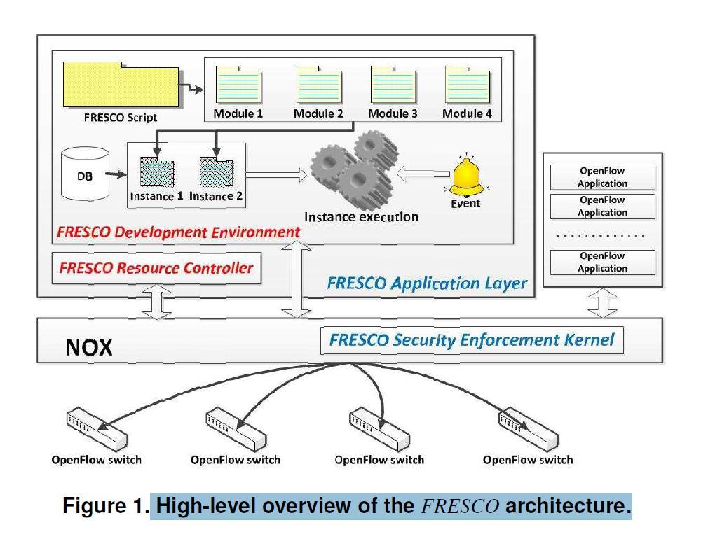

Slide 8
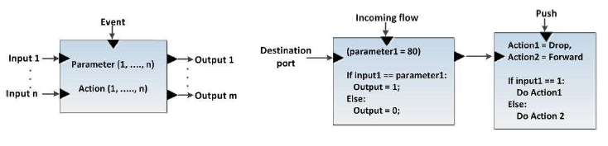
Module Design
input
output
parameter
action
event
Action
Drop
Forward
Group
Set
Redirect
MIrror
Quarantine

Slide 9
Development Environment
Script-to-Module Translation
Registration API:
Administrator give developer an ID and an asymmetric key pair
Developer embed ID in app and sign it with private key
Database Management
Tracking network states
Event Management
Instance execution
Authorize the app ID using public key
Instance is instantiated when event happens
Notes:
Event Manager listens for registered events (even from legacy DPI-based such as Snort) and deliver the event to processing modules

Slide 10
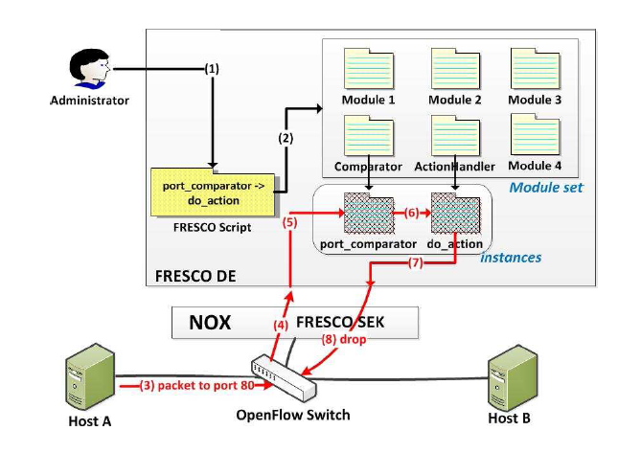
Event Handling

Slide 11
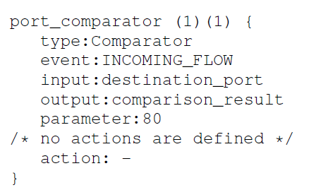
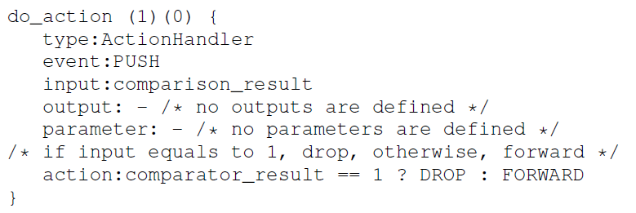
Script Language
Notes:
Two brackets, number of input and output

Slide 12
Resource Controller
Two functions
Switch Monitor
Garbage Collection
LFU Policy
Notes:
Most of the time, the injected security flow has more priority than the general-purpose flow rules. There should be a component being able to do flow rule preemption when the flow table is filled up. It can also prevent the flow table filling up by monitoring the availability of the flow table. If the availability is below a threshold, simply evict the flow rules using Least Frequently Used Policy

Slide 13
Security Enforcement Kernel
No flow conflict reconcile
Security enforcement flows should have higher priority and should never be overwritten by non-security flow rules
SEK
Sign Your Flow !
Detect any rule conflict and resolve it using hierarchy authority model.
Not the major focus of this paper

Slide 14
Case Study: Reflector Net
A FRESCO application that allows OF network operators to redirect malicious scanners to a third-party remote honeypot.

Slide 15
Case Study: Reflector Net
Two Modules
Scan Detector
Event: TCP_CONNECTION_FAIL (from DB)
Input: IP addr causing TCP_CONNECTION_FAIL
Parameter: Threshold
Output: IP addr and scan detection result
Action: Undefined
Redirector
Event: Push
Input: IP addr and Scan detection result
Output: Undefined
Parameter: Undefined
Action: True Scan? Redirect:Forward
Notes:
PUSH: Whenever the module is pushed in an input
Any better ideas here? treat

Slide 16
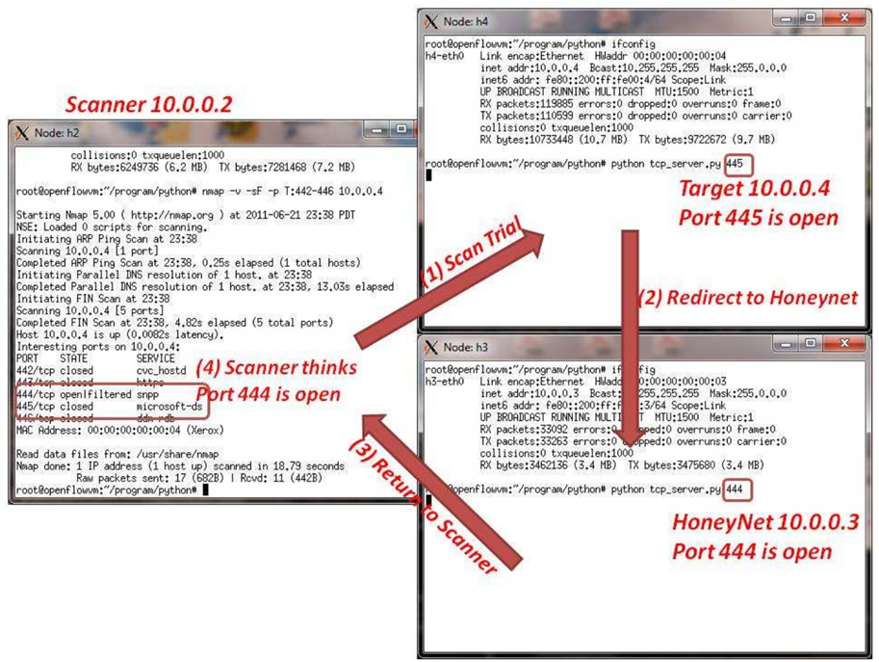
Notes:
More details. The honeynet is designed to accept connections to other IP than itself. For response, it should be able to do IP Spoofing.

Slide 17
Case Study: Cooperating with Legacy Security Applications
FRESCO provides an interface for interacting with legacy security applications such as Snort and BotHunter.
Alerts from these network security monitors can be integrated into the flow rule production logic of OF-enabled networks.

Slide 18
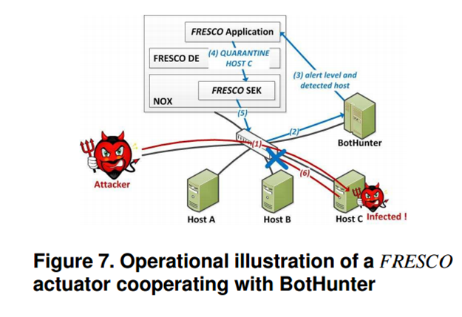
Case Study: Cooperating with Legacy Security Applications

Slide 19
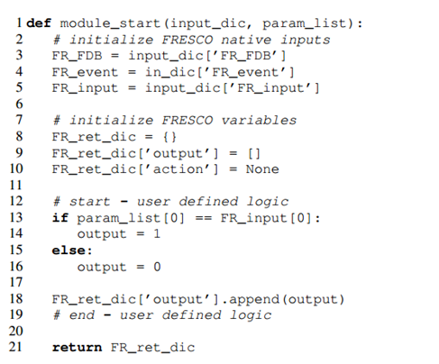
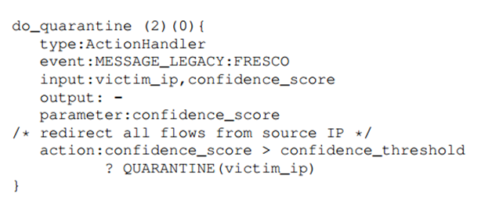
Case Study: Cooperating with Legacy Security Applications

Slide 20
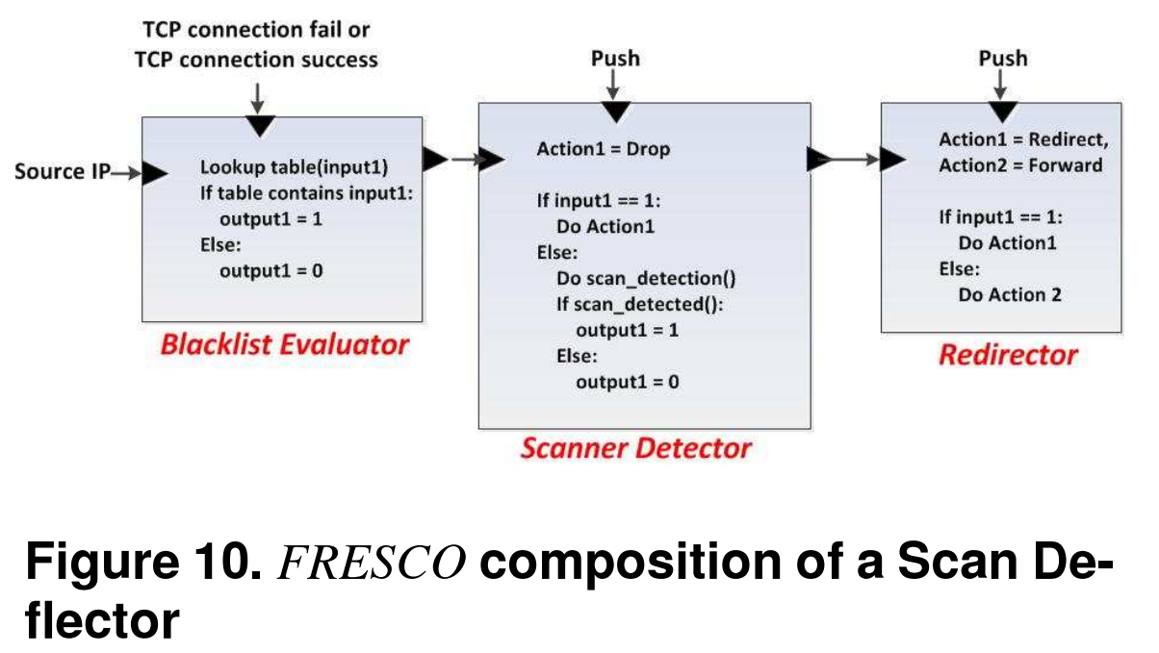
System Evaluation
FRESCO Scan Deflector Service
FRESCO modules and their connections can be linked together to implement a malicious scan deflector for Open-Flow environments

Slide 21
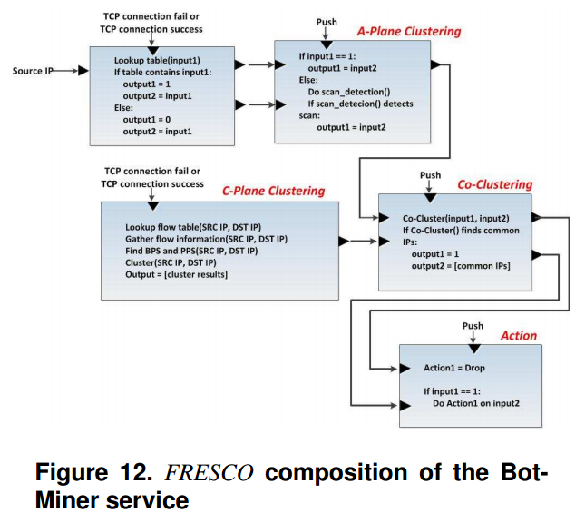
System Evaluation
FRESCO BotMiner Service
BotMiner is an application that detects bots through network-level flow analysis, the essentials of which have been implemented through FRESCO

Slide 22
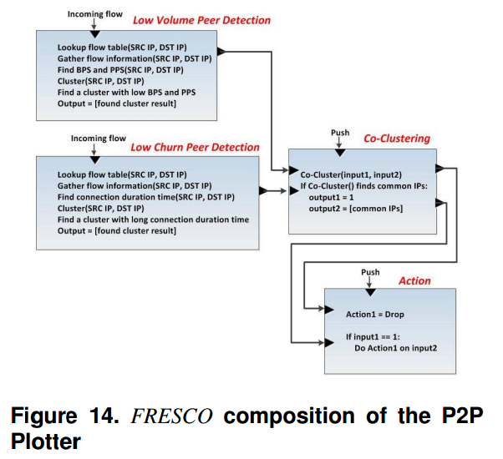
System Evaluation
FRESCO P2P Plotter Service
A P2P malware detection algorithm has been implemented in FRESCO

Slide 23
System Evaluation
FRESCO has shown the ability to implement similar functionality to existing anomaly detection approaches such as TRW with substantially fewer lines of code than previously possible.
FRESCO application require additional setup time between 0.5 ms and 10.9 ms (would likely be improved on a more powerful host as opposed to the emulated environment the testing was done in)

Slide 24
System Evaluation
FRESCO garbage collection is shown to work in the paper, and removes unused flow rules.
FRESCO shows substantial potential in the ability to enhance the rapid prototyping and development of security algorithms in OpenFlow switches

Slide 25
Related Work

Slide 26
FortNOX
SDN apps can compete, contradict, override one another, incorporate vulnerabilities
Worst case: an adversary can use a vulnerable and deterministic SDN app to control the state of all SDN switches in the network

Slide 27
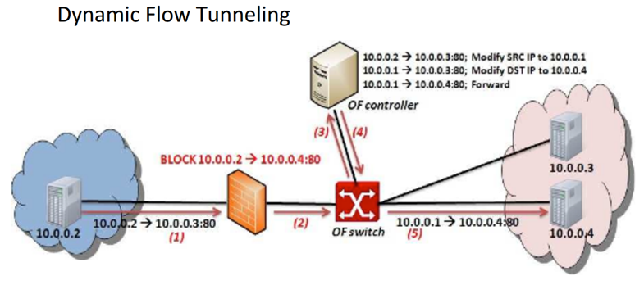
SDN/OpenFlow Evasion Scenario

Slide 28
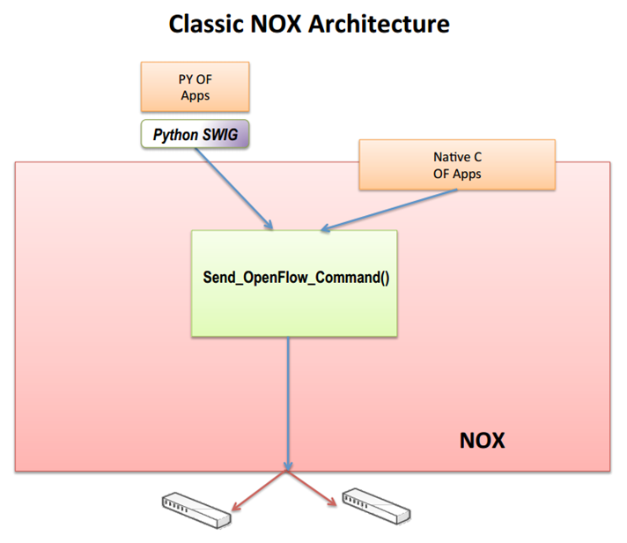

Slide 29
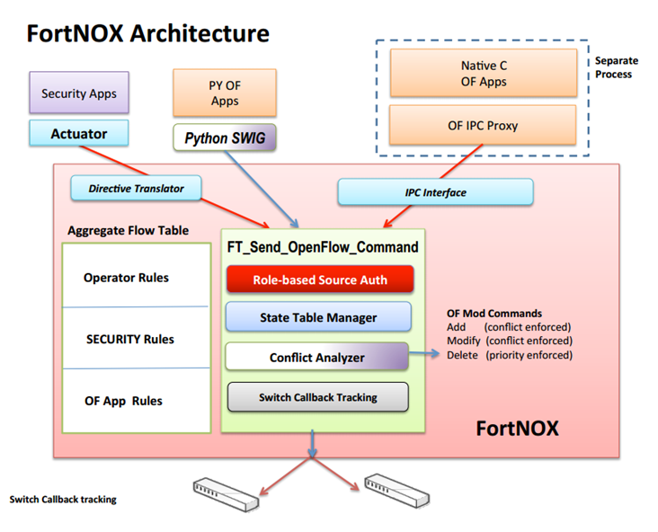

Slide 30
Videos
Video Introduction: : Inside FortNOX [Youtube! ]
Video Demo 1: : Security Constraints Enforcement
[ Youtube! ]
Video Demo 2: : Reflector Nets [ Youtube! ]
Video Demo 3: : Automated Quarantine [ Youtube! ]

Slide 31
Open Issues
FRESCO focuses on detection of rule update conflicts and security policy violations
More general APIs for managing a distributed control plane in SDNs exist (such as Onix), these techniques and strategies could be integrated into FRESCO
Potential expansion could be done in increasing the number and flexibility of FRESCO modules

